Slide 1

User Management
Chetan Shah

Slide 2
User Types in OpenShift Container Platform
There are 3 types of users:
Regular User
System User
Service Account

Slide 3
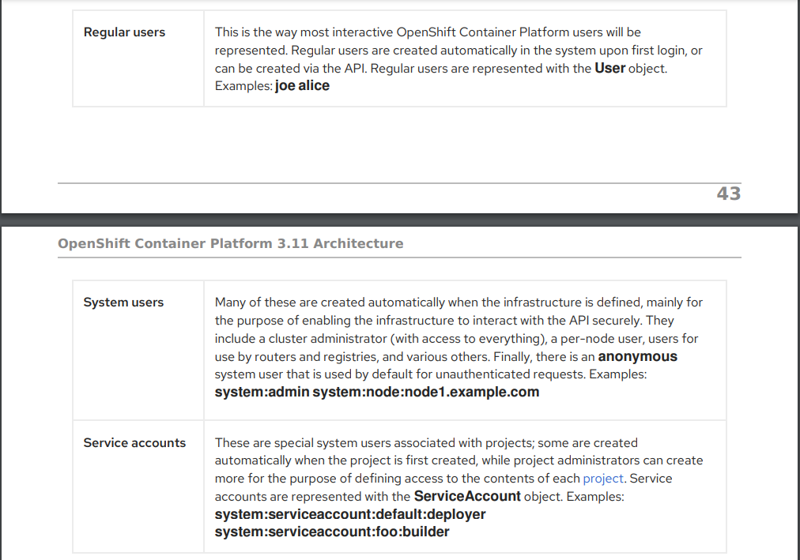
User Types in OpenShift Container Platform

Slide 4
Reference
https://access.redhat.com/documentation/en-us/openshift_container_platform/3.11/pdf/architecture/OpenShift_Container_Platform-3.11-Architecture-en-US.pdf

